Slide 1
Bai 27 De Cuong Trang 31 – 2 cap tiep tuyen cat nhau
Bai 49 De Cuong = De Thay Sang
Bai 28 De Cuong - Hay

Slide 2
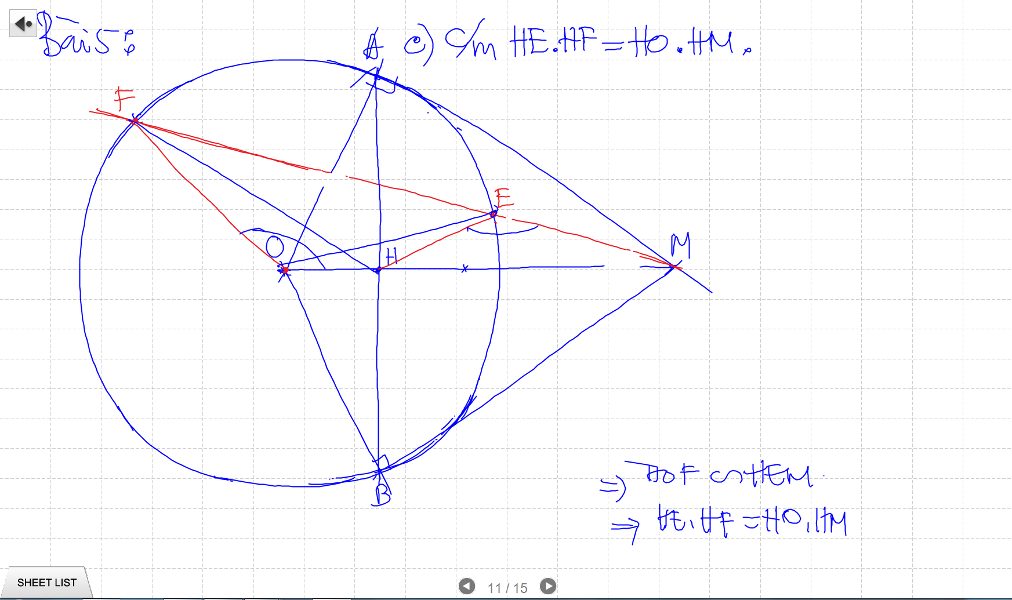

Slide 3
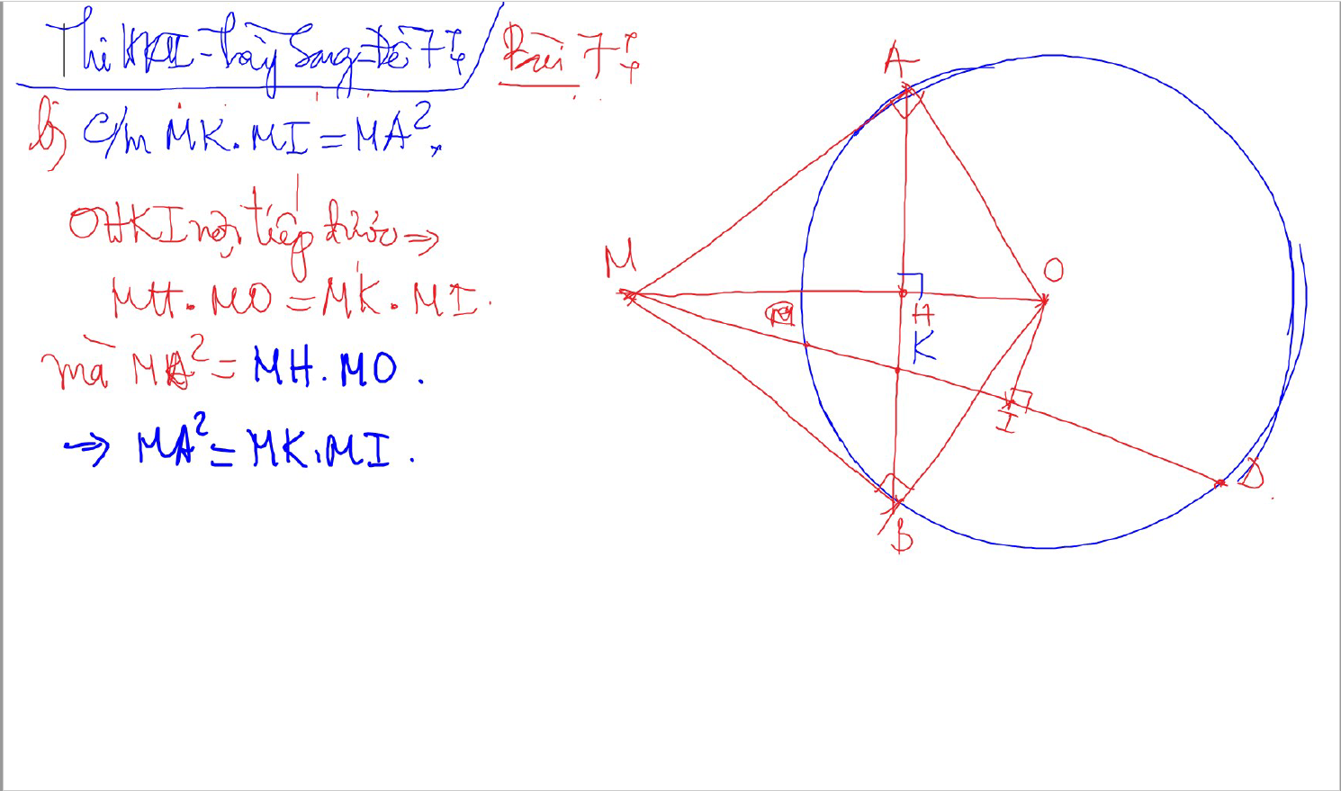
CM Vuong goc VOI DAY CUNG bang cach ve them tiep tuyen

Slide 4
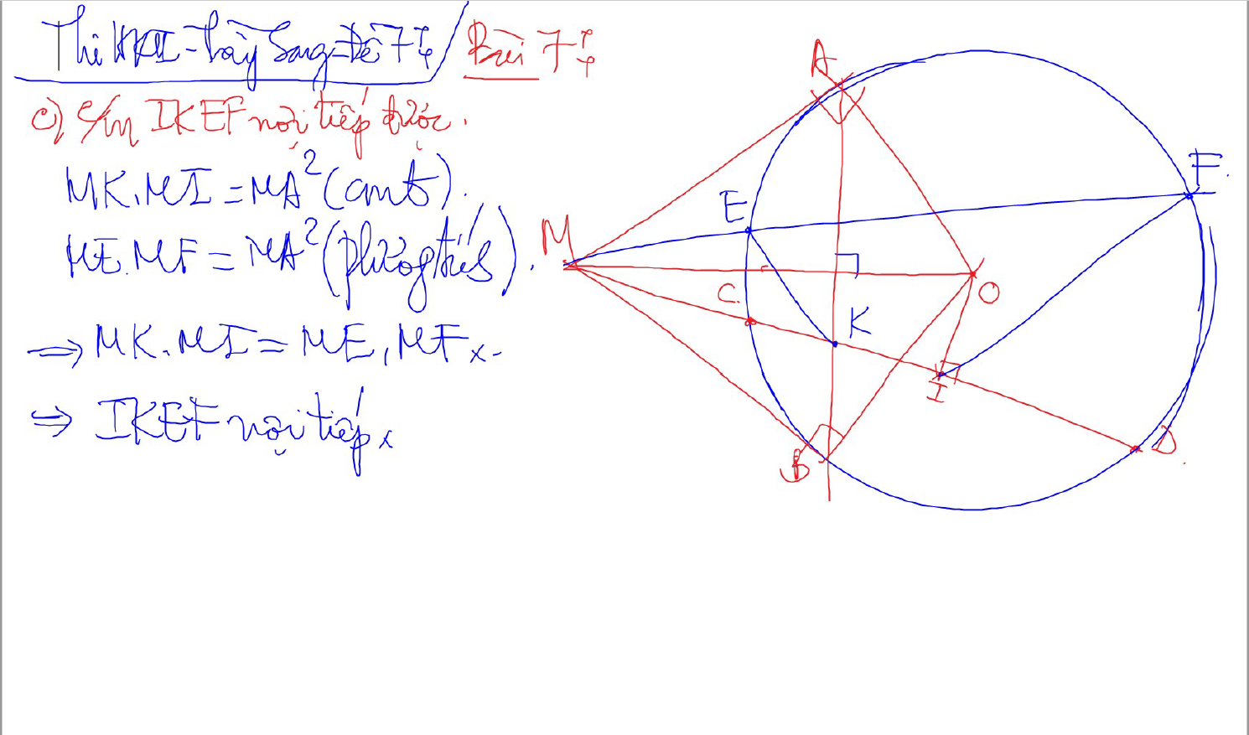
THE BUP MANG

Slide 5
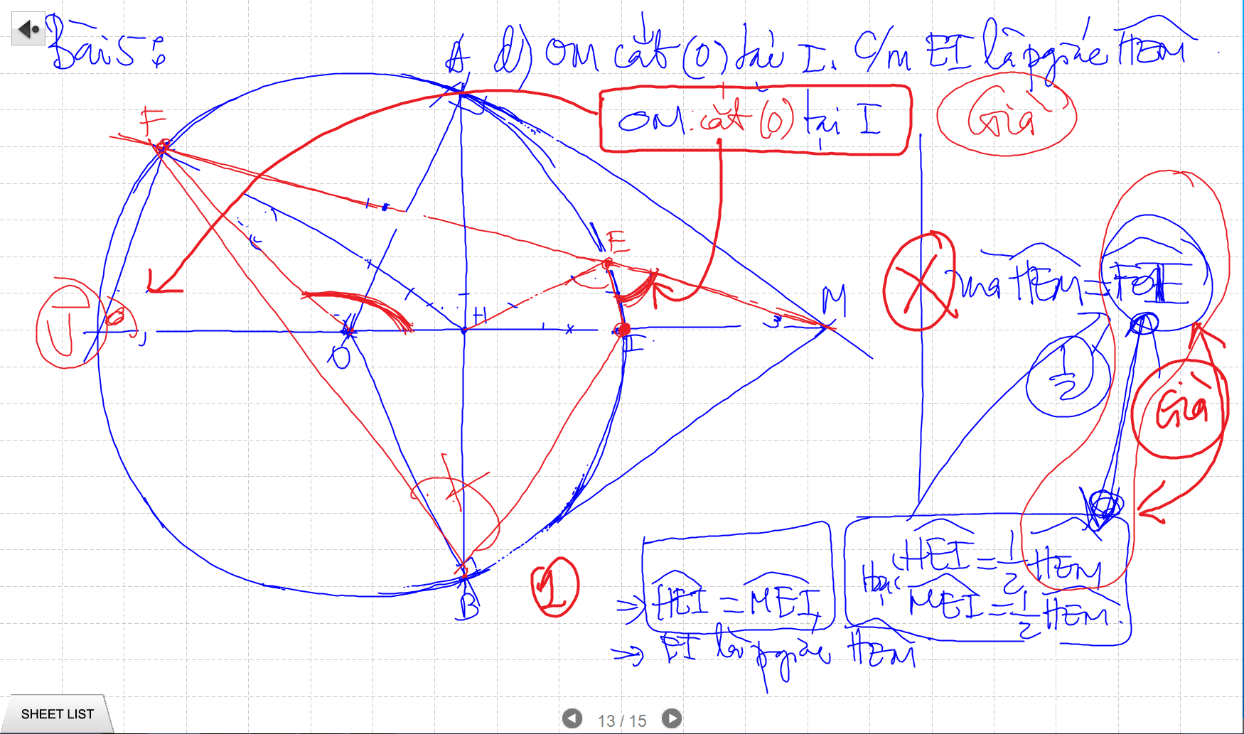

Slide 6
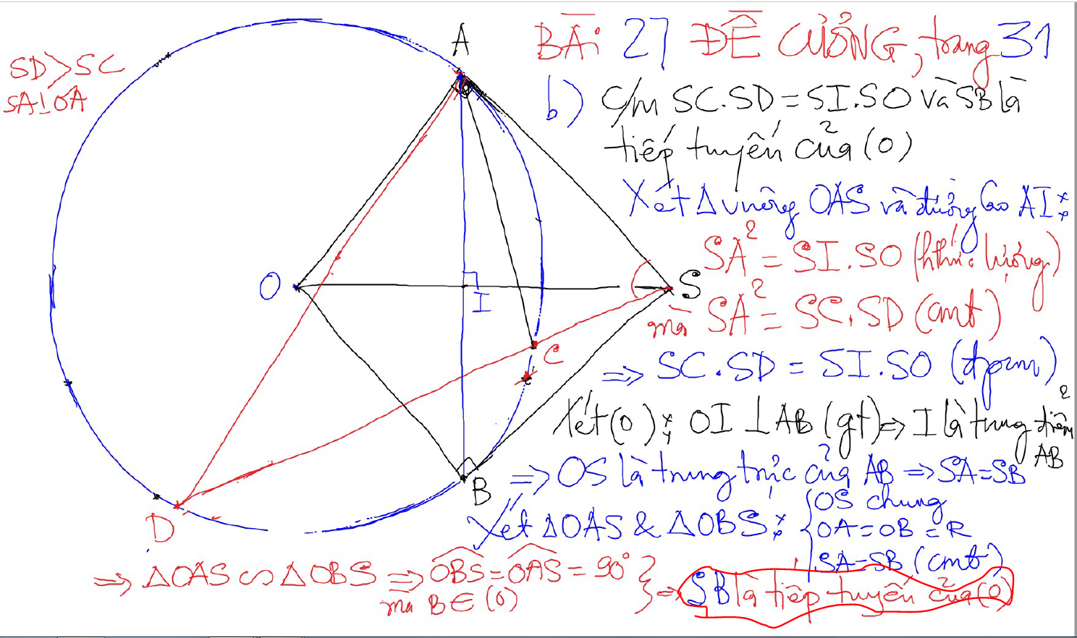
Bai 27 De Cuong Trang 31 – 2 cap tiep tuyen cat nhau

Slide 7
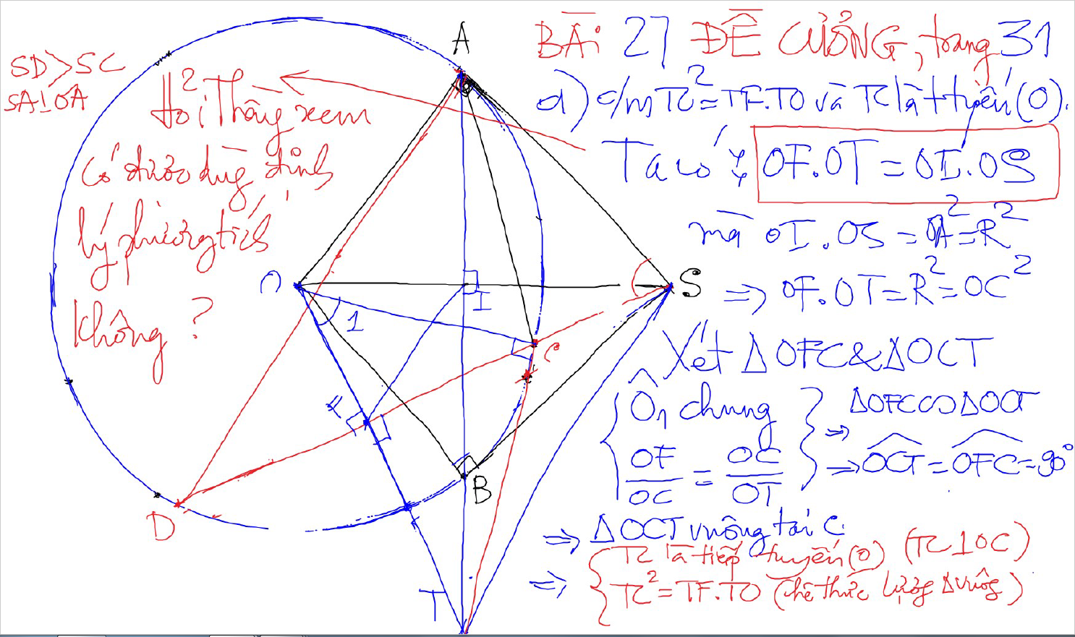
Bai 27 De Cuong Trang 31 – 2 cap tiep tuyen cat nhau

Slide 8
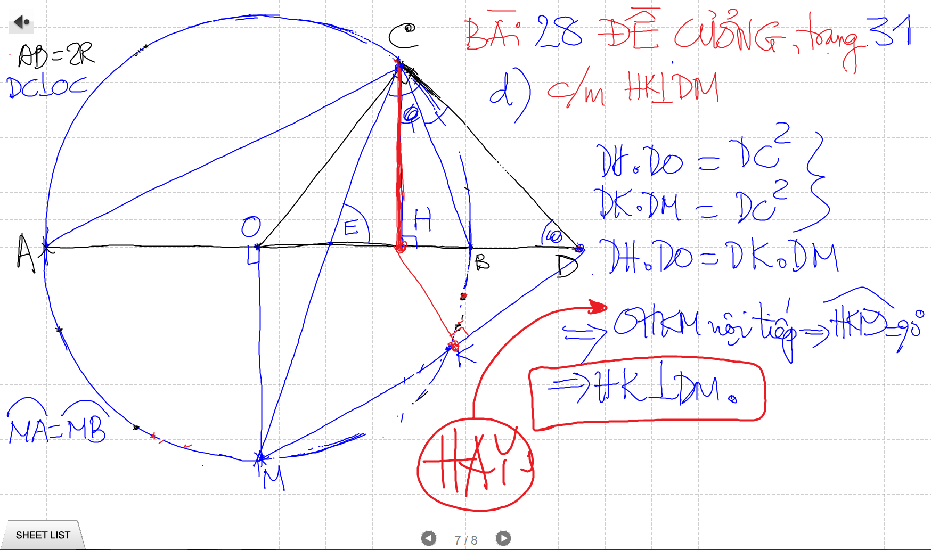
Bai 27 De Cuong Trang 31 – 2 cap tiep tuyen cat nhau

Slide 9
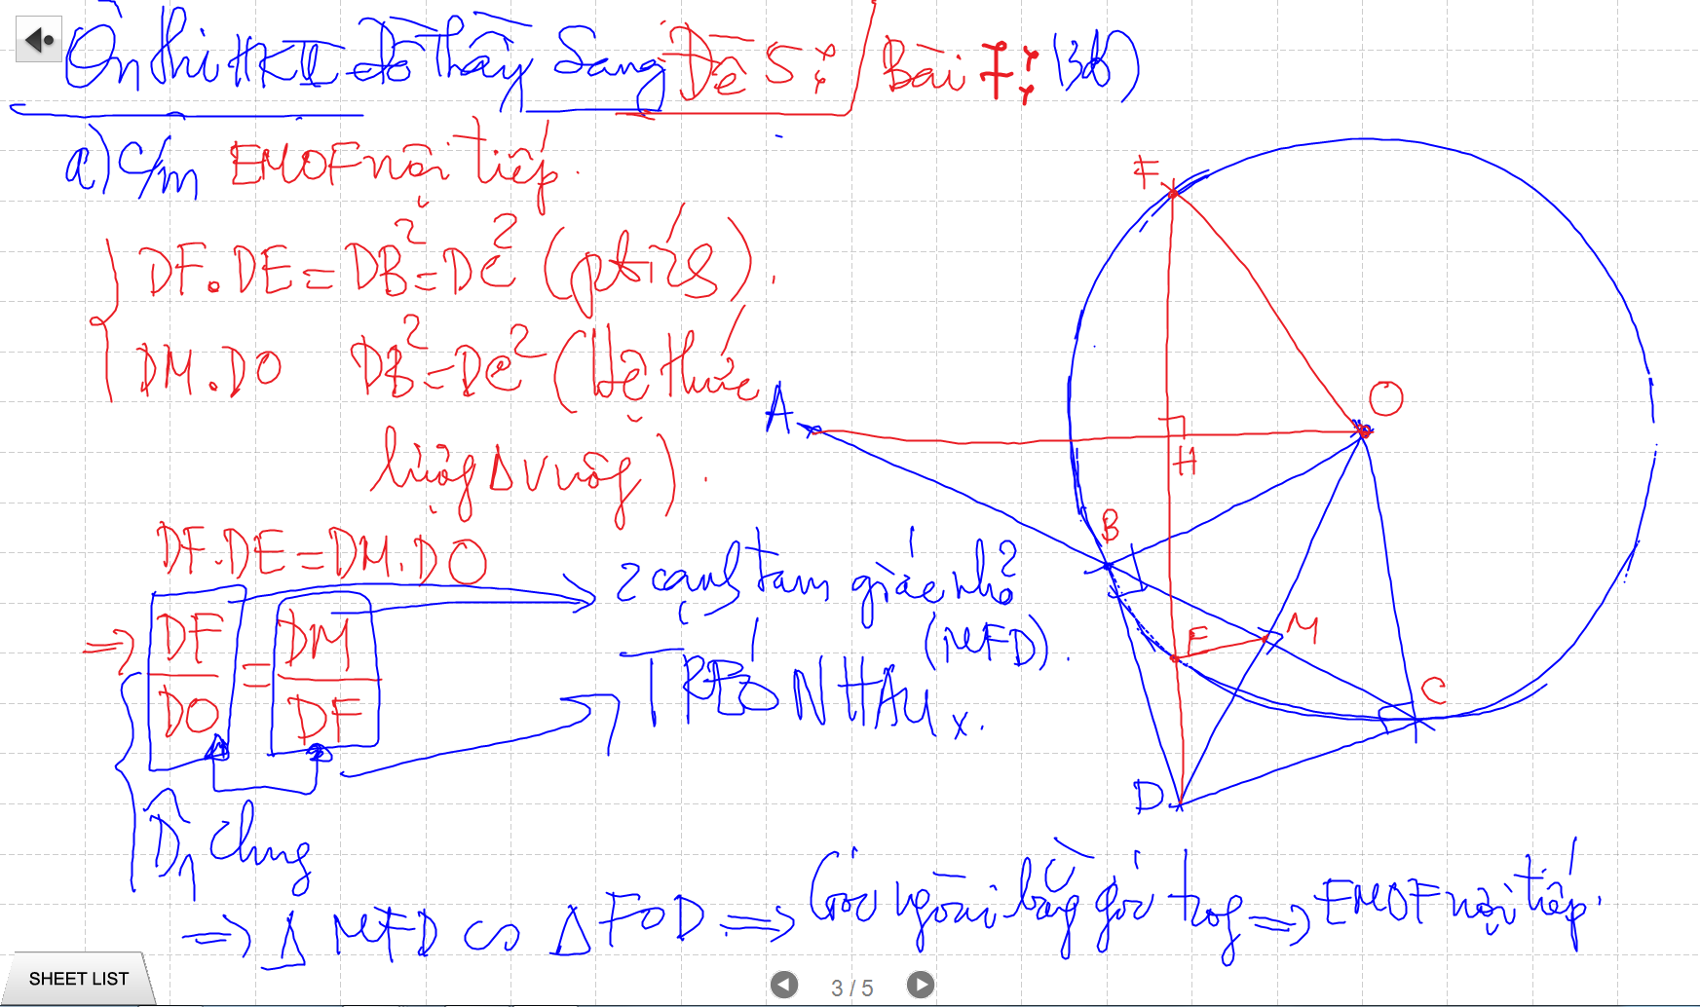
TIEP TUYEN & CAT TUYEN – De Thay Sang – 49 DC

Slide 10
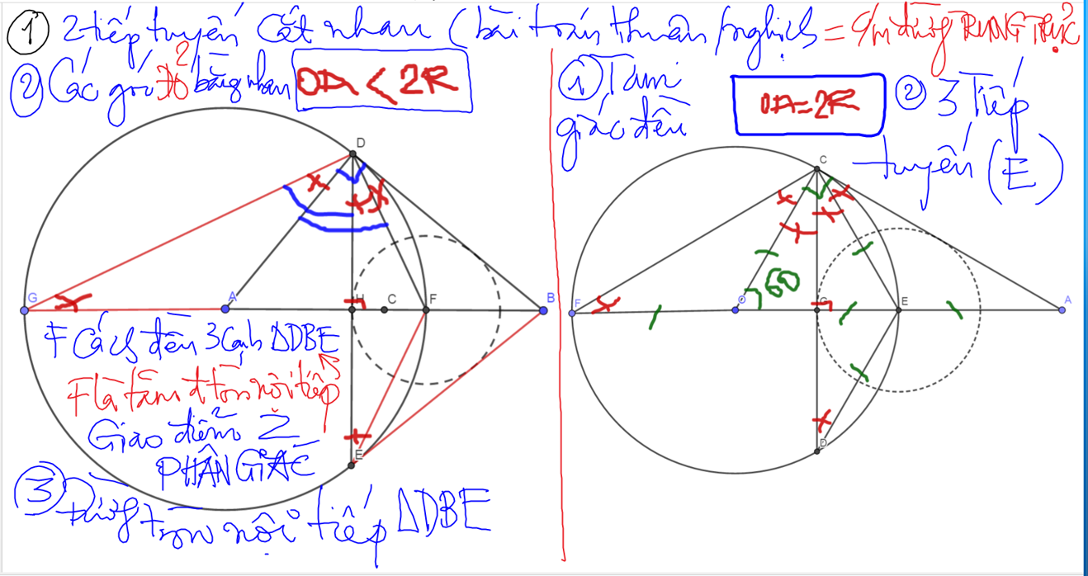

Slide 11
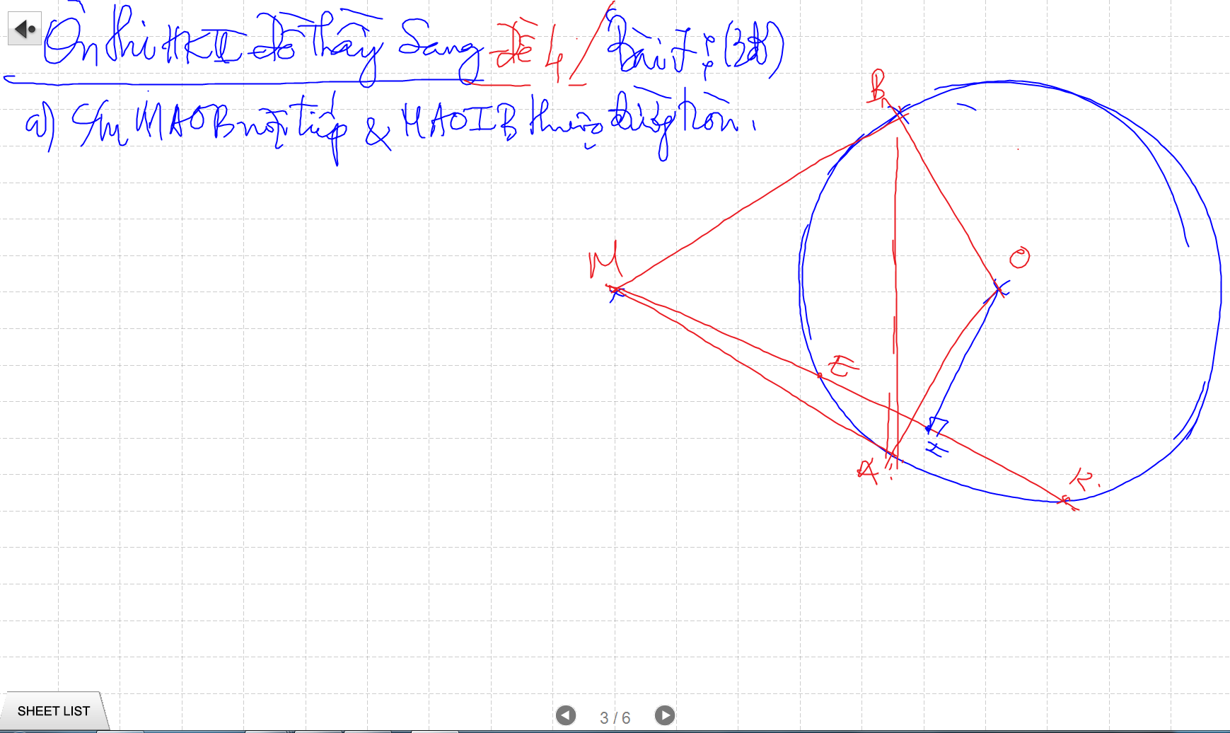

Slide 12
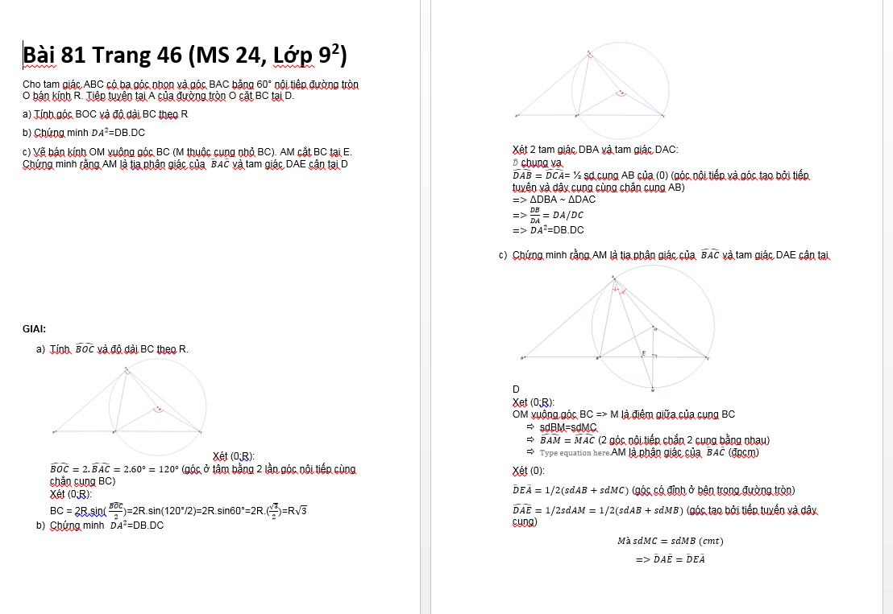

Slide 13
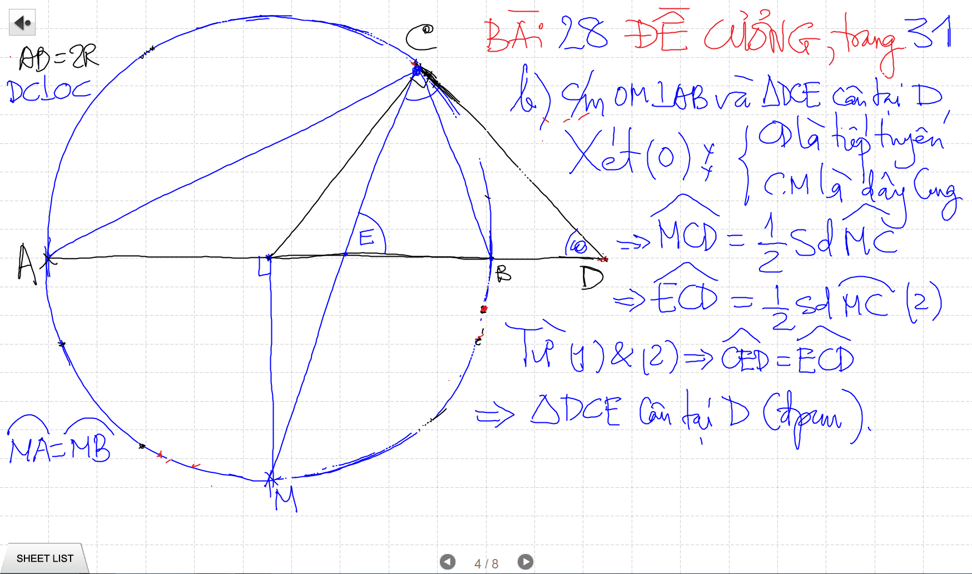
Cac De nay kho vi no TRUU TUONG. Phai co kinh Nghiem biet doi nhanh cac bieu thuc SO HOC

Slide 14
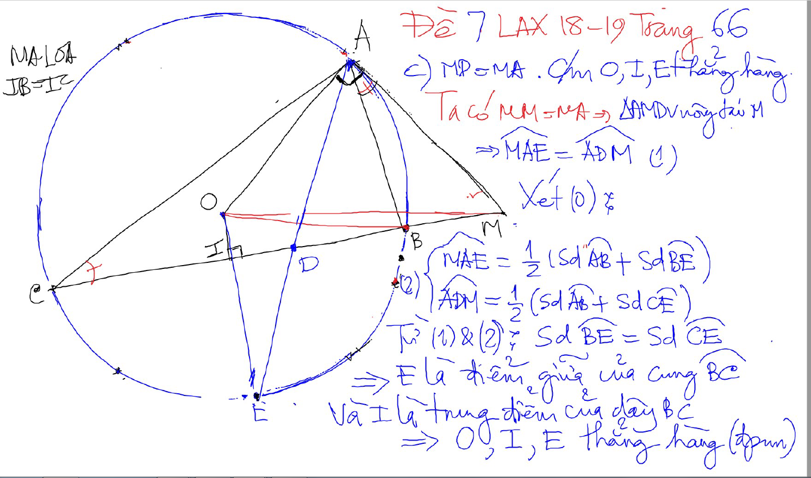
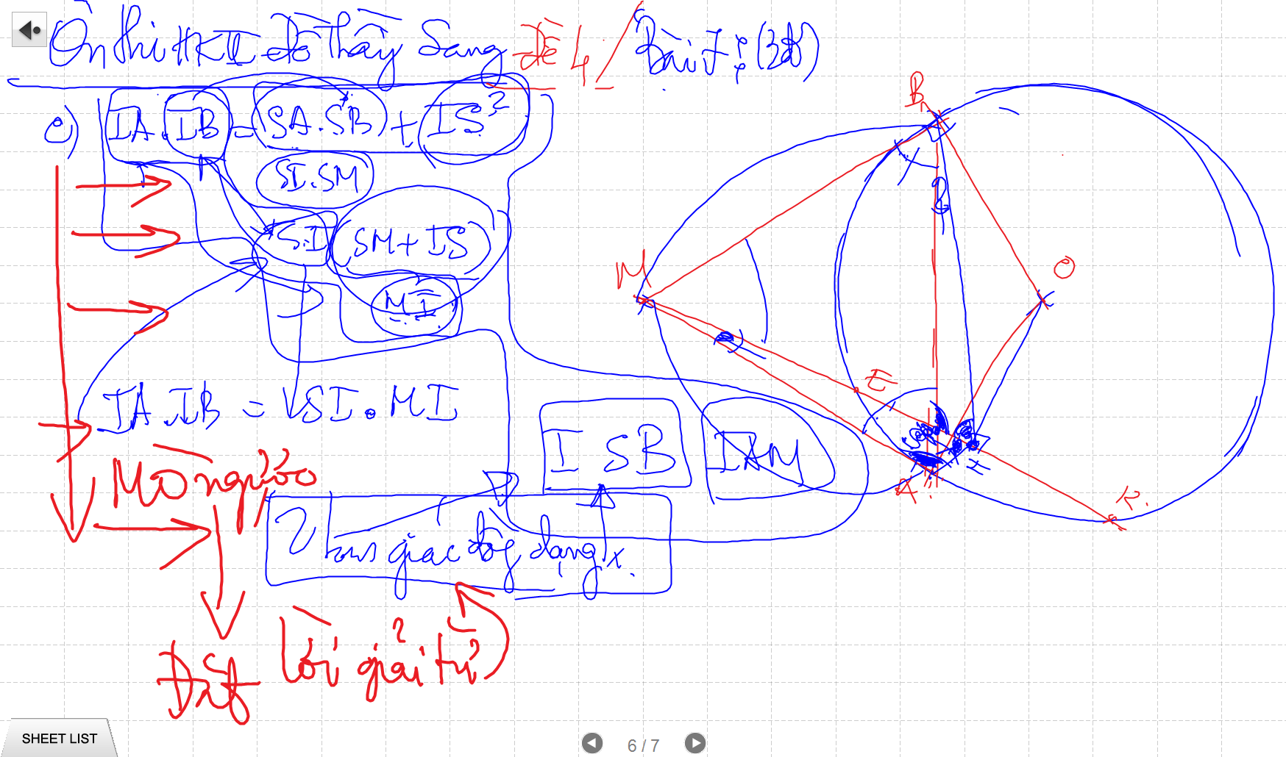
Cac De nay kho vi no TRUU TUONG. Phai co kinh Nghiem biet doi nhanh cac bieu thuc SO HOC

Slide 15
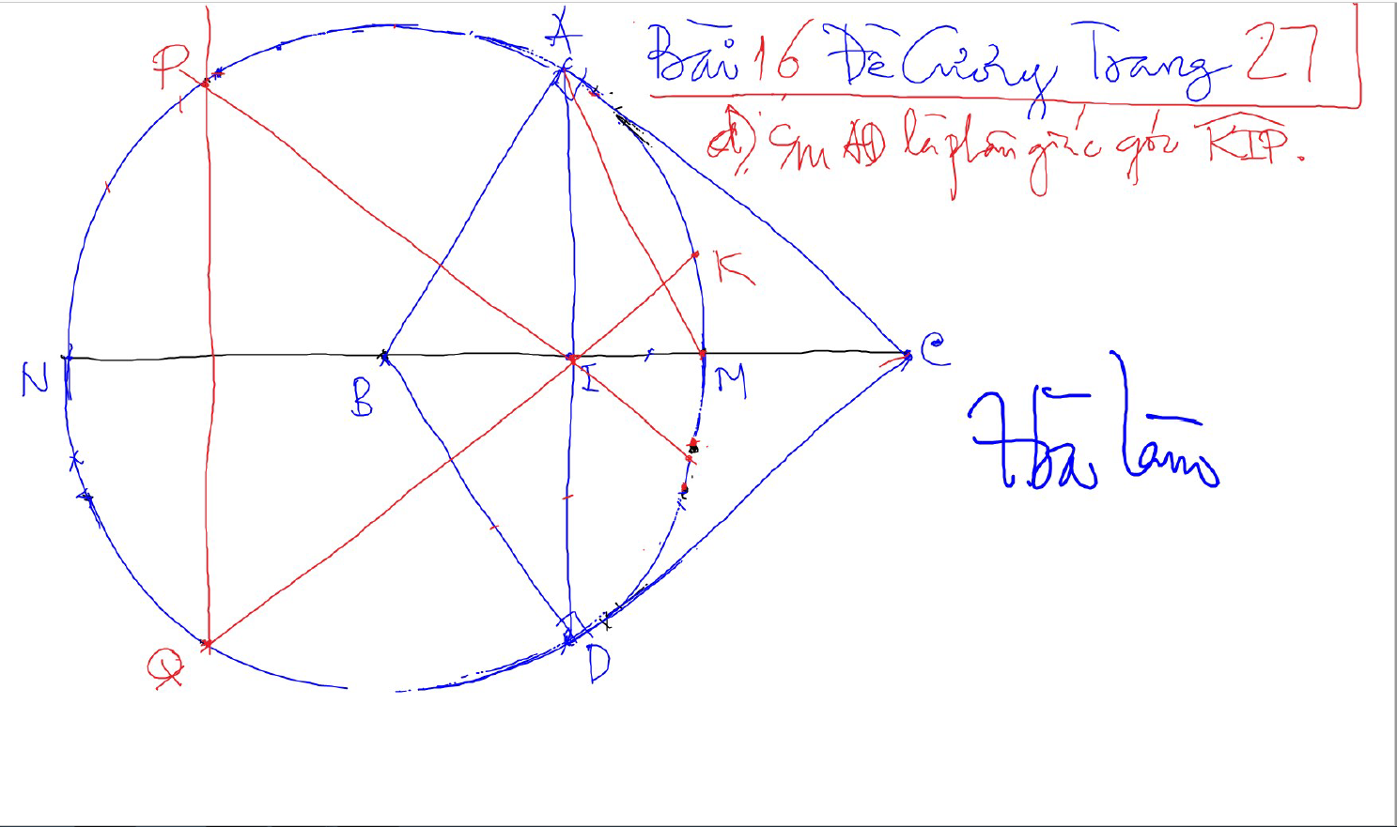
TIEP TUYEN & CAT TUYEN – De Thay Sang – 49 DC

Slide 16
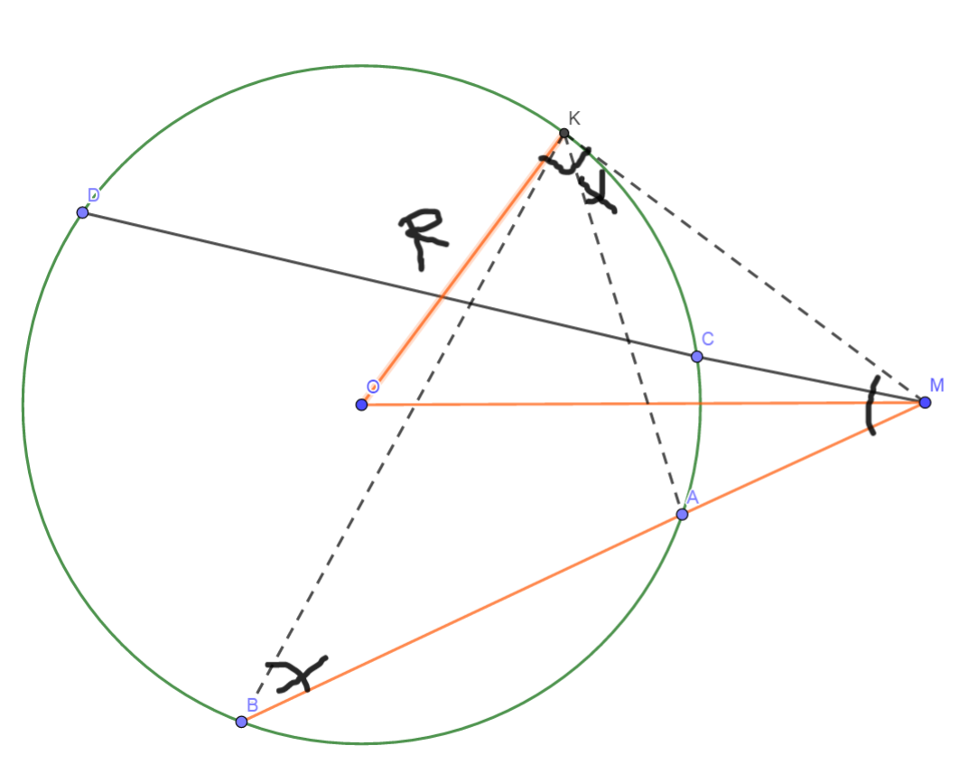
Phuong Tich cua mot diem nam ben ngoai duong tron
MA.MB=OM²-R²
He qua:
MA.MB=MC.MD=OM²-R²

Slide 17
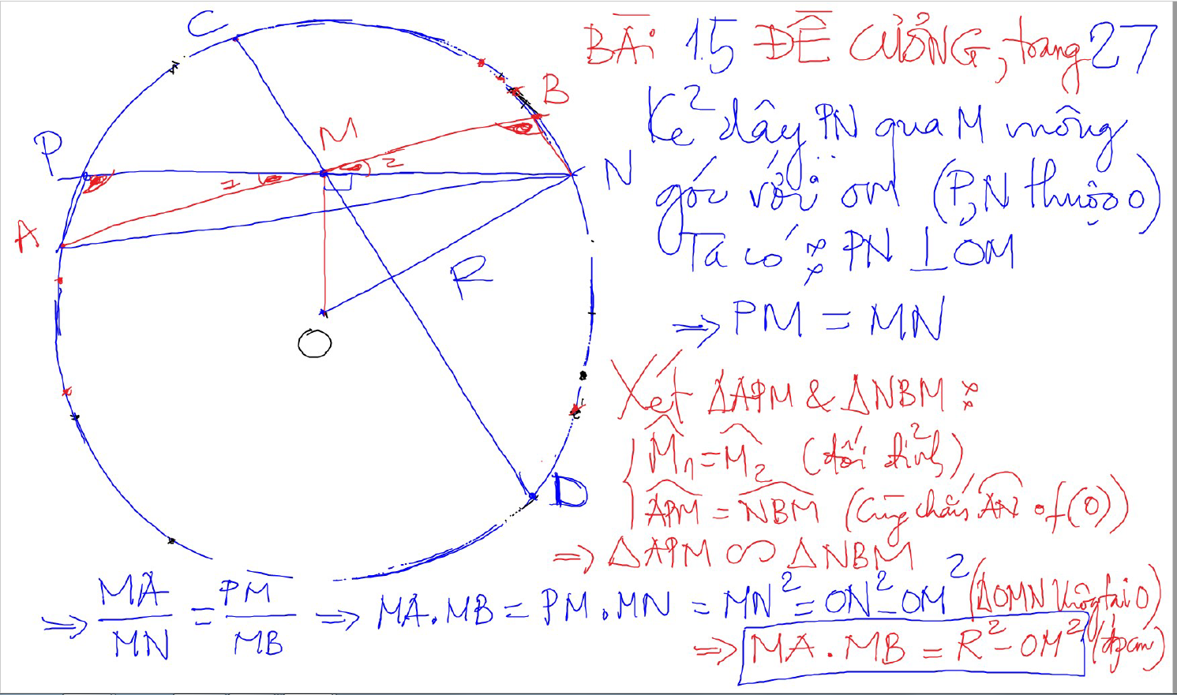
Phuong Tich cua mot diem nam ben TRONG duong tron
MA.MB=OM²-R²
He qua:
MA.MB=MC.MD=OM²-R²

Slide 18
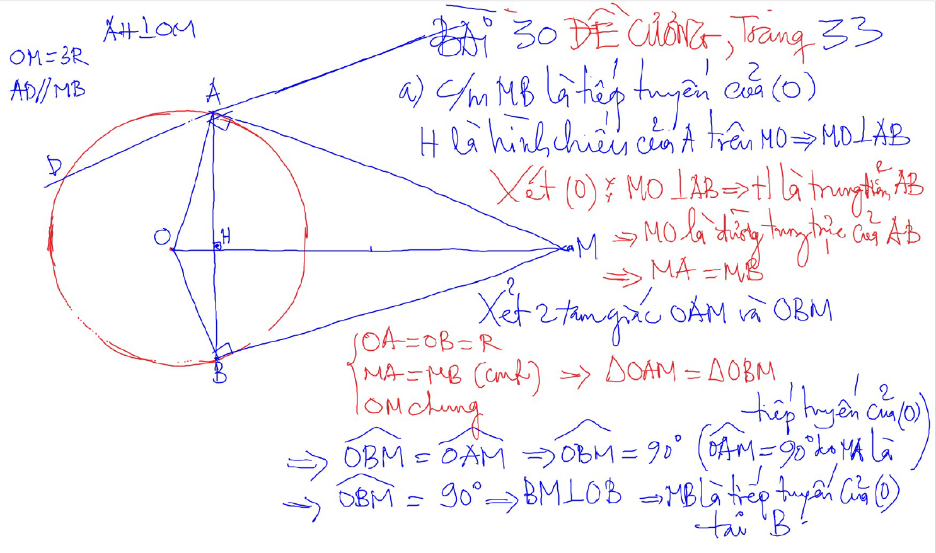
CM Tiep tuyen bang cach CM VUONG GOC

Slide 19
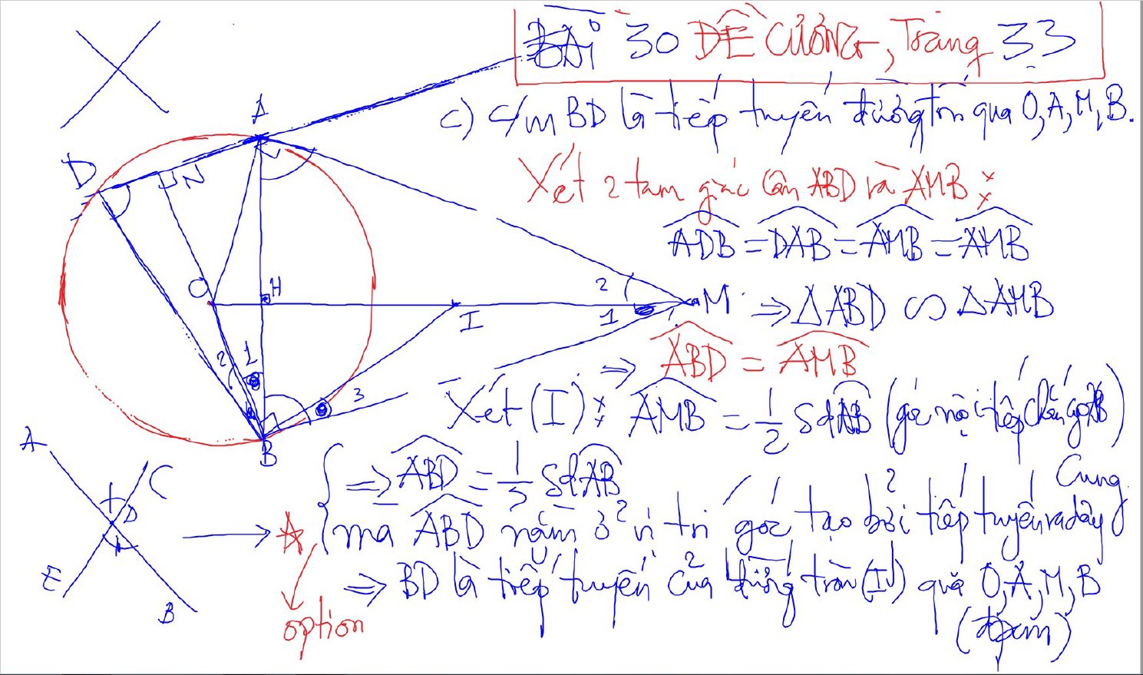
CM Tiep tuyen bang cach dung goc tao boi tiep tuyen va day cung

Slide 20
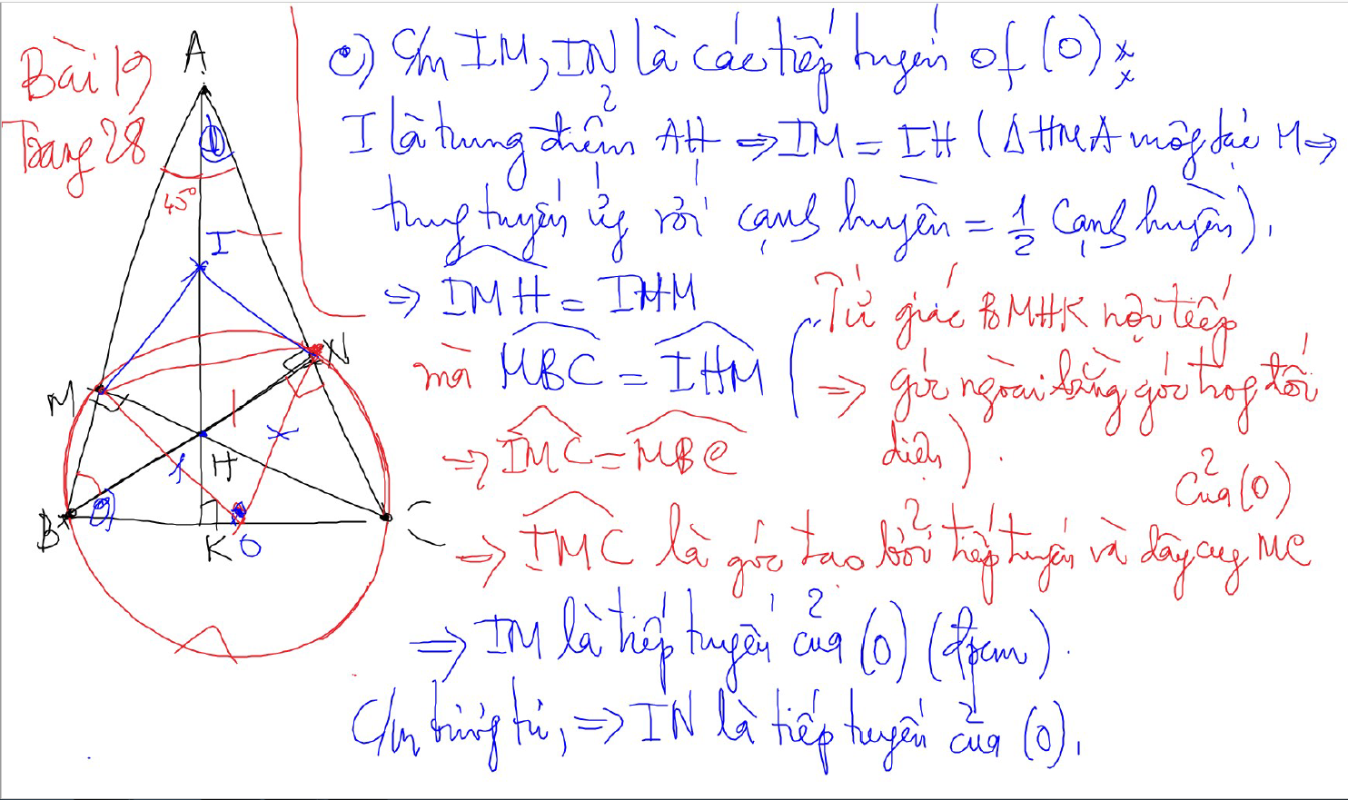
CM Tiep tuyen bang cach dung goc tao boi tiep tuyen va day cung

Slide 21
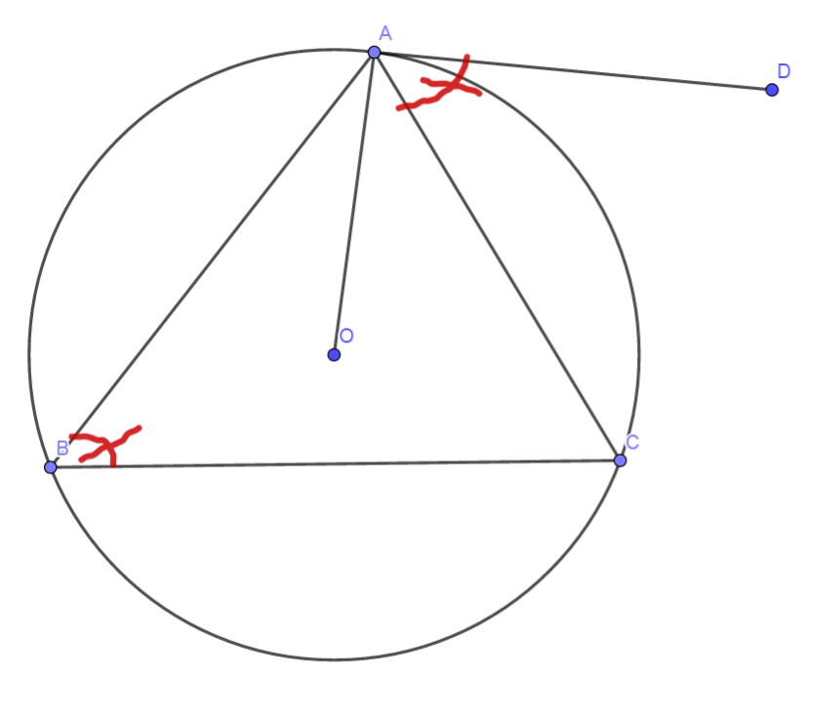
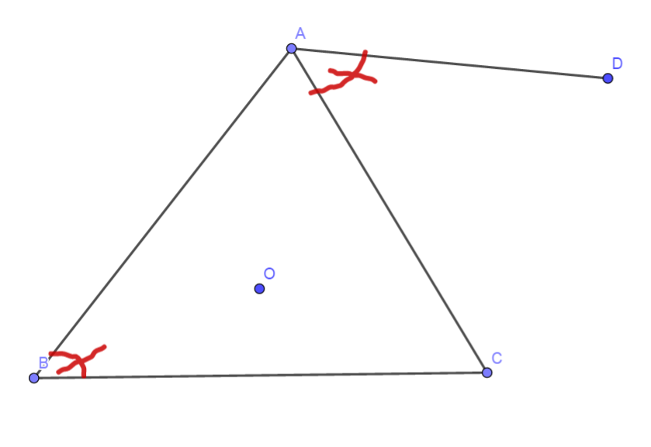
CM Tiep tuyen bang cach dung goc tao boi tiep tuyen va day cung
Chung minh tiep tuyen bang dinh ly dao cua goc tao boi tiep tuyen va day cung va goc noi tiep cung chan 1 cung:
GT: Goc ABC = Goc DAC
KL: DA la tiep tuyen

Slide 22
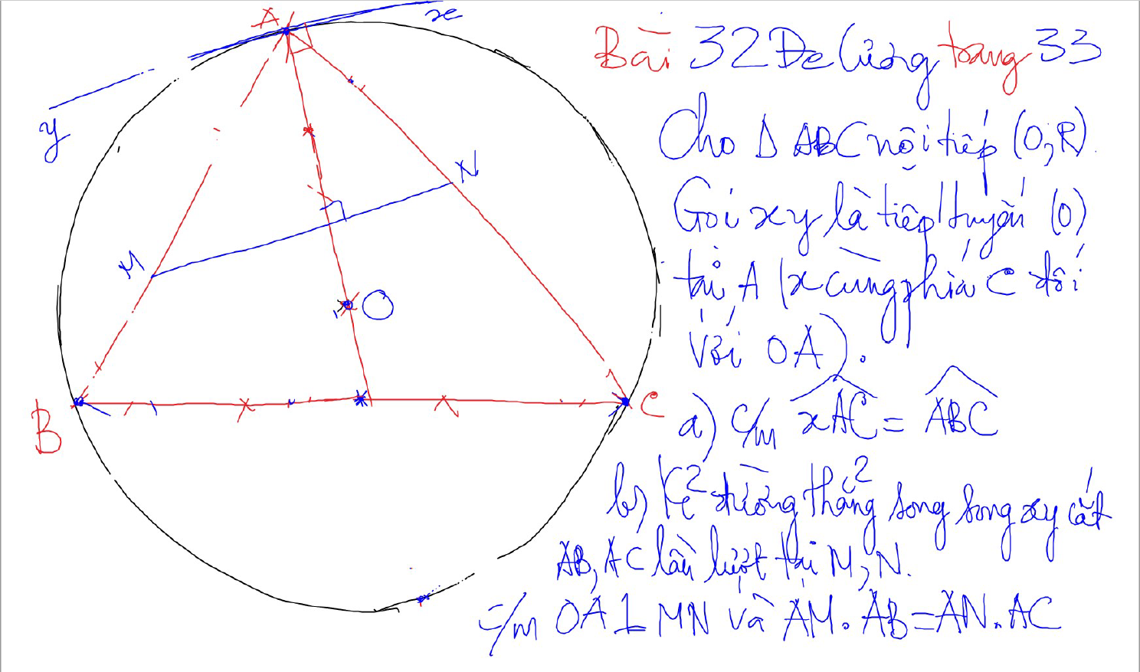
CM Vuong goc VOI DAY CUNG bang cach ve them tiep tuyen

Slide 23
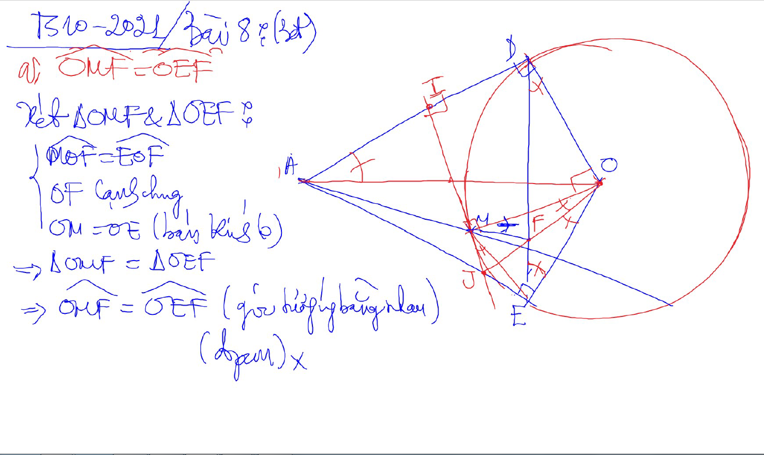
2 tam giac dong dang (truong hop 1)

Slide 24
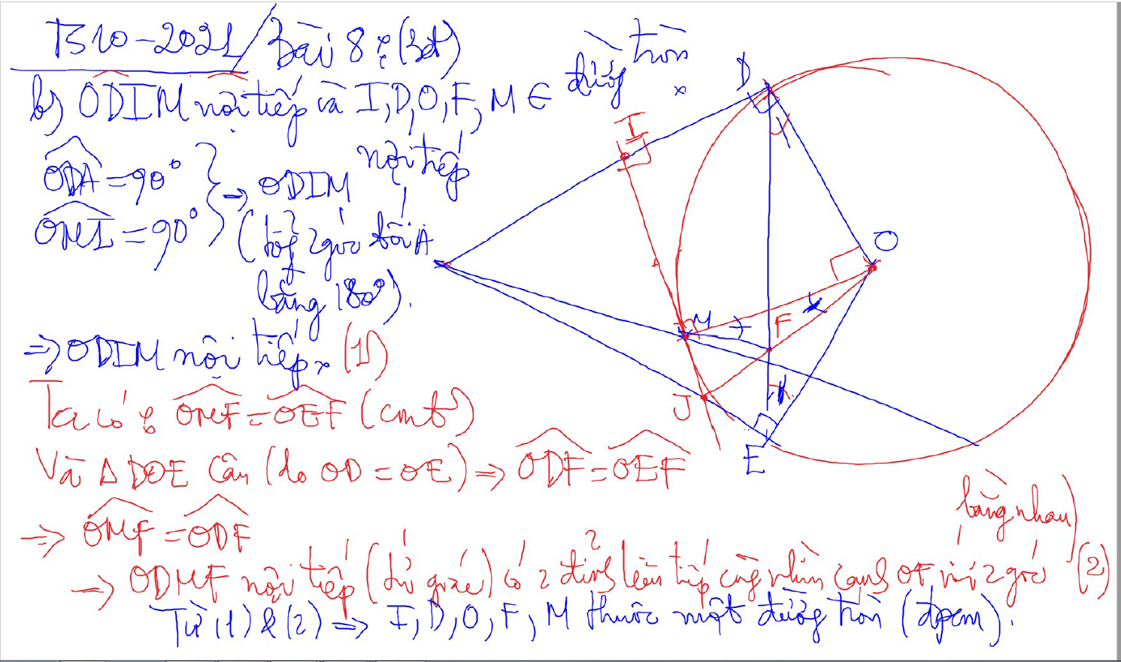
2 tam giac dong dang (truong hop 1)

Slide 25
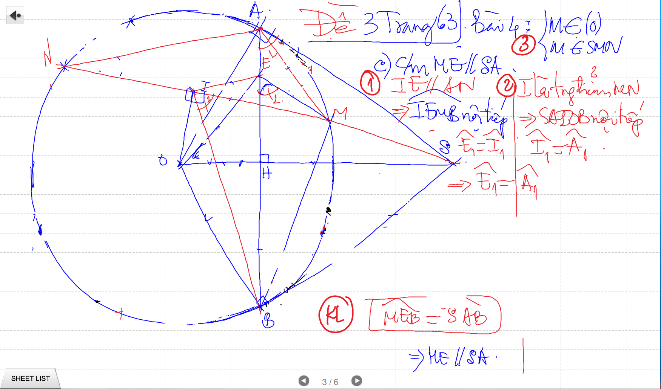

Slide 26
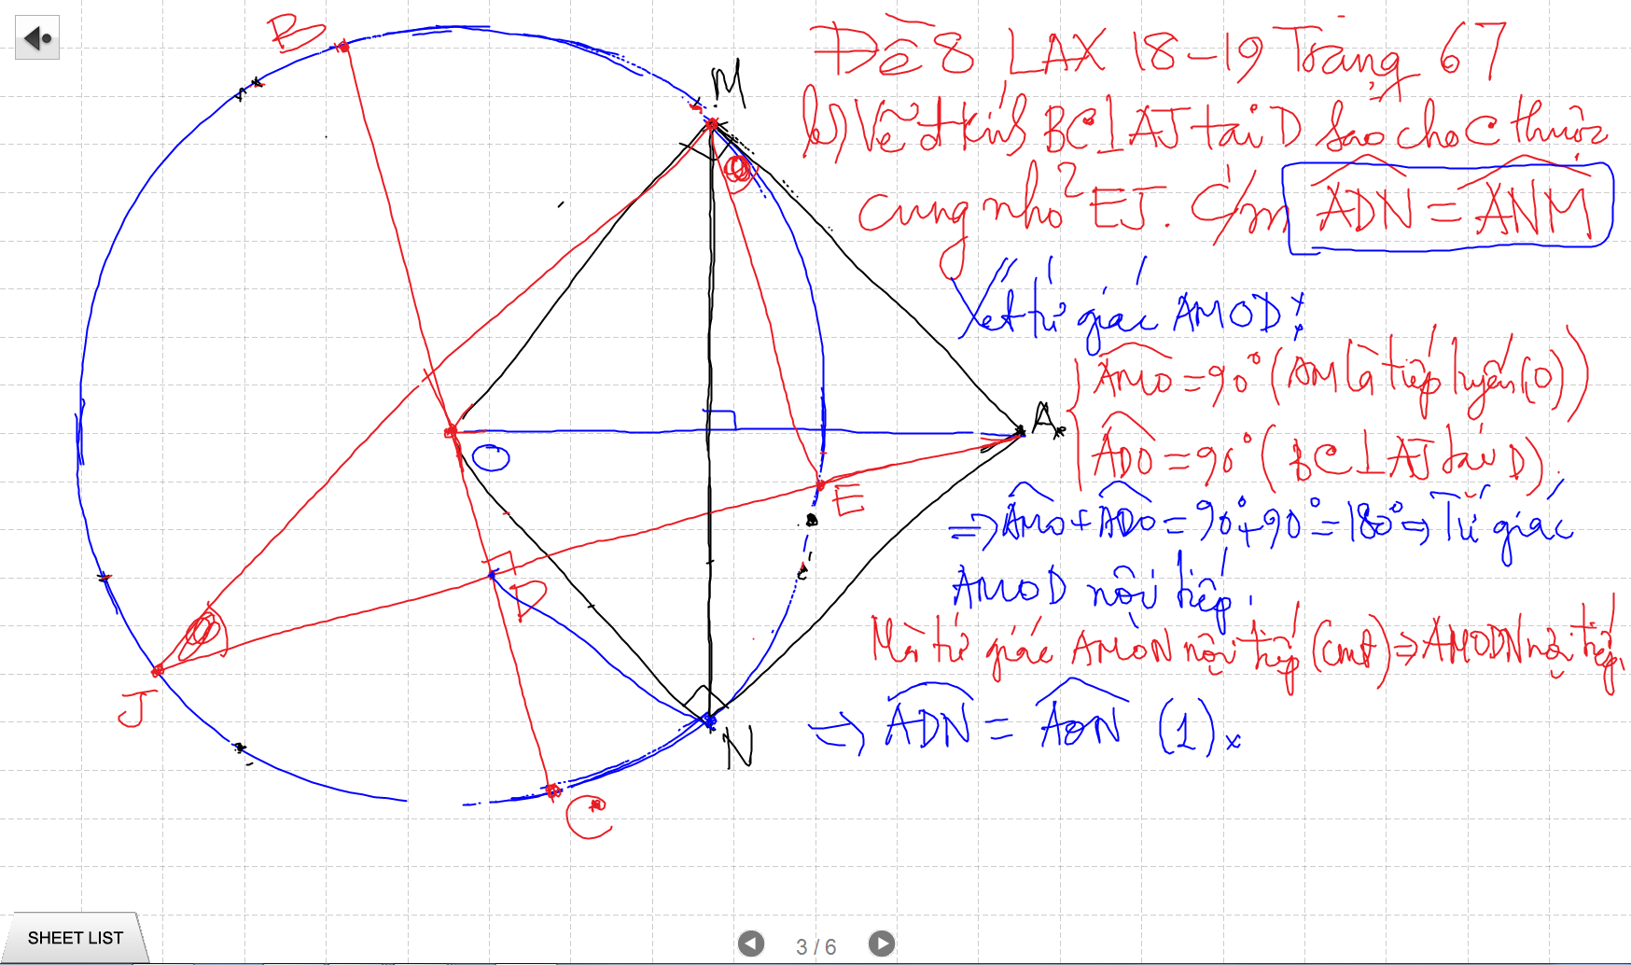
CM Vuong goc VOI DAY CUNG bang cach ve them tiep tuyen

Slide 27
CM Vuong goc VOI DAY CUNG bang cach ve them tiep tuyen

